Slide 1


DATA MINING FOR AIRLINE SATISFACTION
A Lecture Presentation

Slide 2
CONTENT
Overview
Data visualization
Preprocessing
Experimental
Evaluation
Conclusion

Slide 3

1. OVERVIEW

Slide 4

REASON
The rapid development of the aviation industry leads to great competition in this industry. Understanding customers, knowing whether they are satisfied or not, thereby improving quality is very necessary.

Slide 5
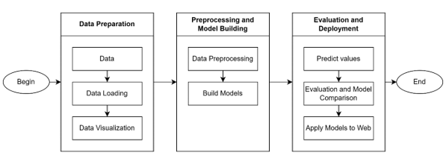
PROCESS

Slide 6
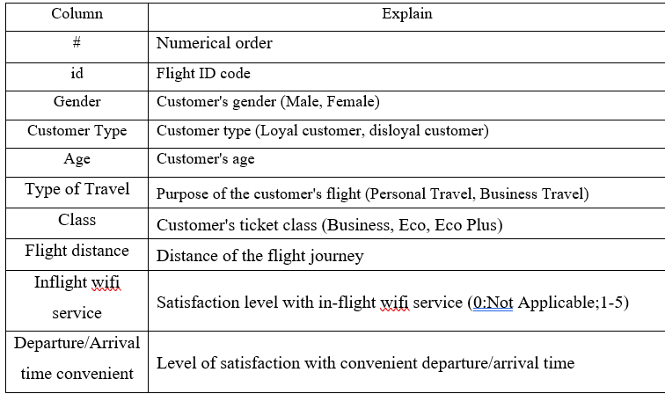

DATA OVERVIEW

Slide 7
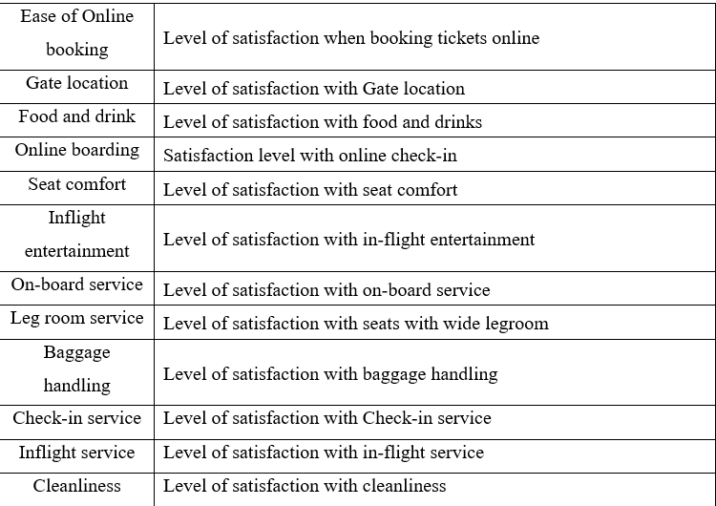
DATA OVERVIEW

Slide 8
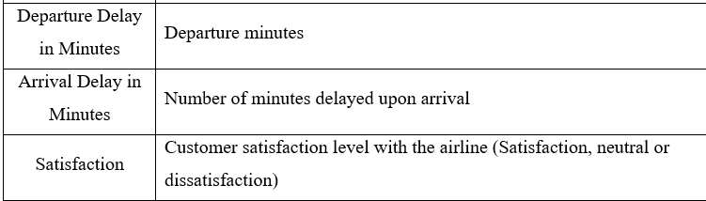

DATA OVERVIEW

Slide 9

2. DATA VISUALIZATION

Slide 10

DATA VISUALIZATION
Distribution of Customer Satisfaction
Distribution of 'Gender' and its influence on satisfaction levels
Distribution of 'Age' and its influence on satisfaction levels
Sastifaction by Age and Gender 10
Distribution of ‘Customer Type’ and its influence on satisfaction levels.
Distribution of ‘Type of Travel’ and ‘Travel Class ’
Distribution of Flight Distance
Service quality analysis
Correlation between delays (departure and arrival) and satisfaction levels

Slide 11
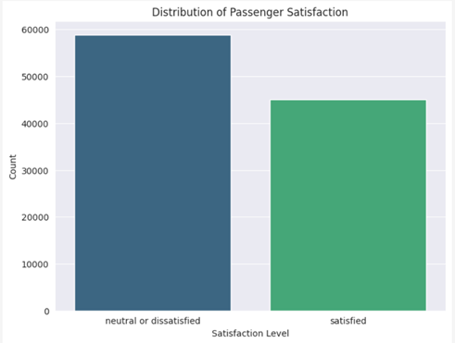
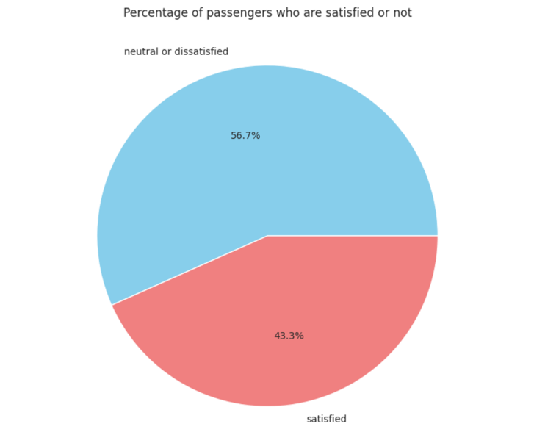
DISTRIBUTION OF CUSTOMER SATISFACTION
This analysis reveals that the number of dissatisfied passengers exceeds that of satisfied passengers by a noticeable margin, indicating an imbalance in our train data.

Slide 12
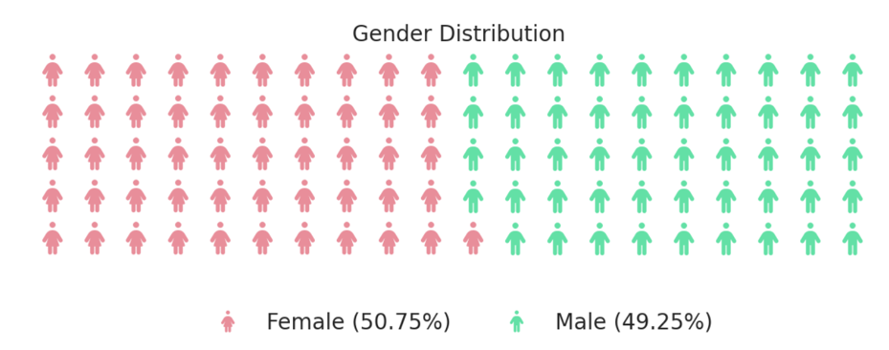
DISTRIBUTION OF 'GENDER' AND ITS INFLUENCE ON SATISFACTION LEVELS
The distribution of gender among passengers is nearly balanced, with a relatively equal representation of male and female travelers.

Slide 13
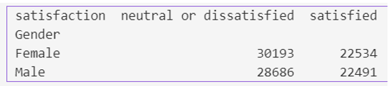
DISTRIBUTION OF 'GENDER' AND ITS INFLUENCE ON SATISFACTION LEVELS
There are 22534 satisfied and 30193 dissatisfied female customer.
There are 22491 satisfied and 28868 dissatisfied male customer.

Slide 14
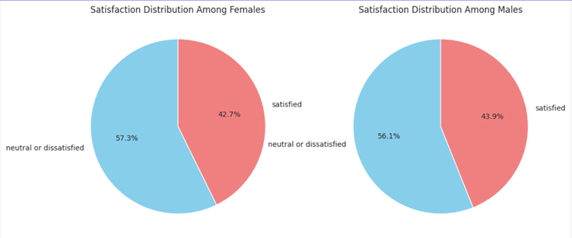
DISTRIBUTION OF 'GENDER' AND ITS INFLUENCE ON SATISFACTION LEVELS
In general, the data indicates an even distribution of satisfaction between genders, with a slightly higher percentage of satisfied individuals in both male and female groups.

Slide 15
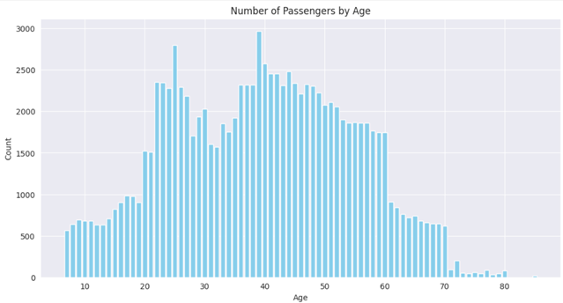
DISTRIBUTION OF 'AGE' AND ITS INFLUENCE ON SATISFACTION LEVELS
The individuals in the dataset span a wide range of ages, from 7 to 85 years old. This broad age range reflects the diversity of generations.

Slide 16
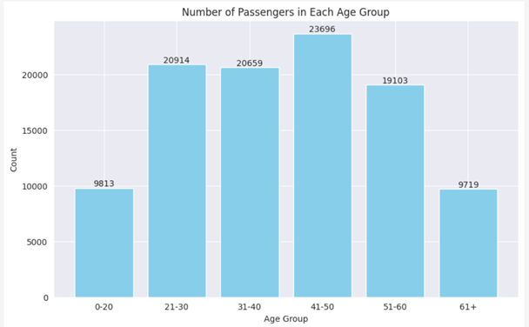
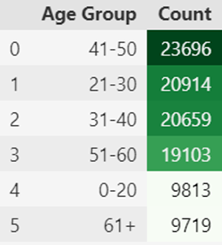
DISTRIBUTION OF 'AGE' AND ITS INFLUENCE ON SATISFACTION LEVELS
PREDOMINANT AGE GROUP
Overall, the data exhibits a diverse distribution across various age groups, with a notable concentration in the '41-50,' '21-30,' and '31-40' categories. Meanwhile, the '0-20' group. Although they are the smallest, still represents a significant portion of the dataset.

Slide 17
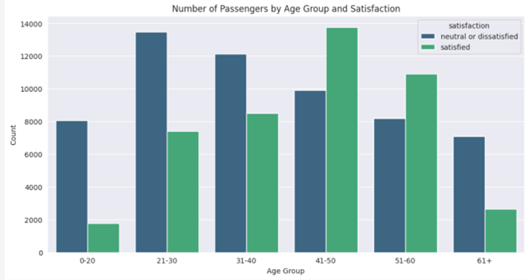
DISTRIBUTION OF 'AGE' AND ITS INFLUENCE ON SATISFACTION LEVELS
PREDOMINANT AGE GROUP
To sum up, the data uncovers intriguing satisfaction patterns among various age groups. Higher satisfaction levels are observed in the 41-50 and 51-60 age brackets, whereas the 0-20 and 61+ age groups demonstrate larger proportions of individuals expressing neutrality or dissatisfaction. The 31-40 age group falls in the middle, suggesting a relatively balanced distribution of sentiments.

Slide 18
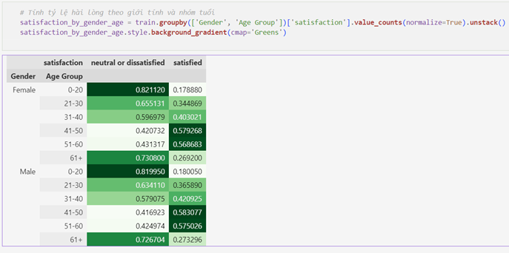
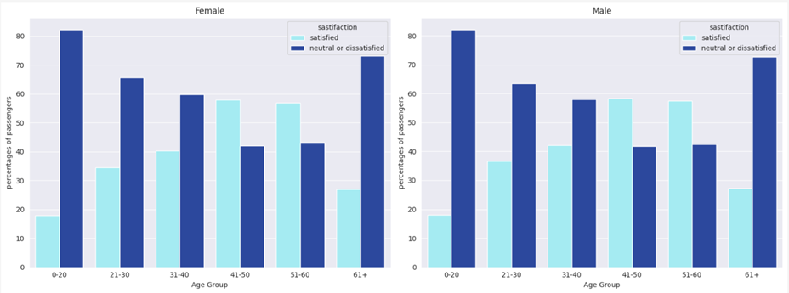
SASTIFACTION BY AGE AND GENDER
In a broader sense, the data suggests consistent satisfaction patterns between genders throughout various age groups, with only slight variations. Generally, younger age groups tend to show higher proportions of neutrality or dissatisfaction, whereas older age groups demonstrate elevated levels of satisfaction.

Slide 19
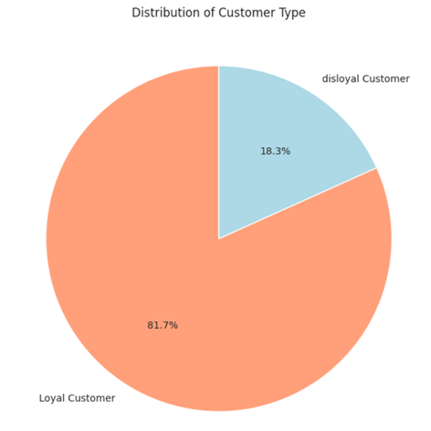
DISTRIBUTION OF ‘CUSTOMER TYPE’ AND ITS INFLUENCE ON SATISFACTION LEVELS
Most customers (over 80%) belong to the loyal customer category, underscoring a robust rate of customer retention.

Slide 20
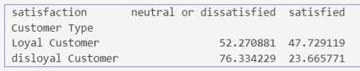
DISTRIBUTION OF ‘CUSTOMER TYPE’ AND ITS INFLUENCE ON SATISFACTION LEVELS
RELATIONSHIP BETWEEN SATISFACTION, AGE AND LOYALTY
Loyal customers typically exhibit a well-balanced distribution between neutral/dissatisfied and satisfied sentiments, while a significant majority of disloyal customers express either neutrality or dissatisfaction.

Slide 21
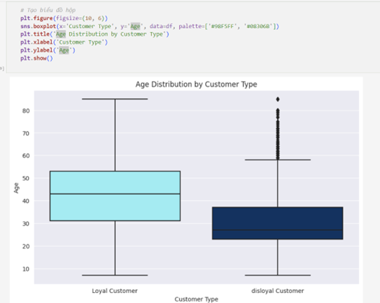
DISTRIBUTION OF ‘CUSTOMER TYPE’ AND ITS INFLUENCE ON SATISFACTION LEVELS
RELATIONSHIP BETWEEN SATISFACTION, AGE AND LOYALTY
On average, loyal customers are older in comparison to their disloyal counterparts. Age appears to be a potential contributing factor to customer loyalty, as older individuals demonstrate a higher likelihood of being classified as loyal customers.

Slide 22
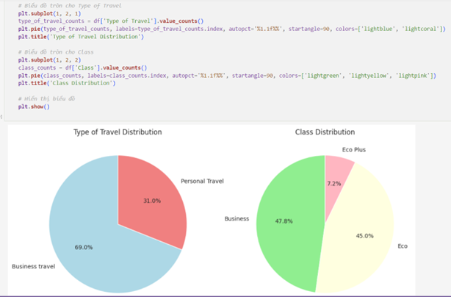
DISTRIBUTION OF ‘TYPE OF TRAVEL’ AND ‘TRAVEL CLASS’
In general, ‘Business Travel’ take a higher count compared to ‘Personal Travel’. Furthermore, the Economy class exhibits the highest ticket count, followed by Business class and Economy Plus class in descending order.

Slide 23
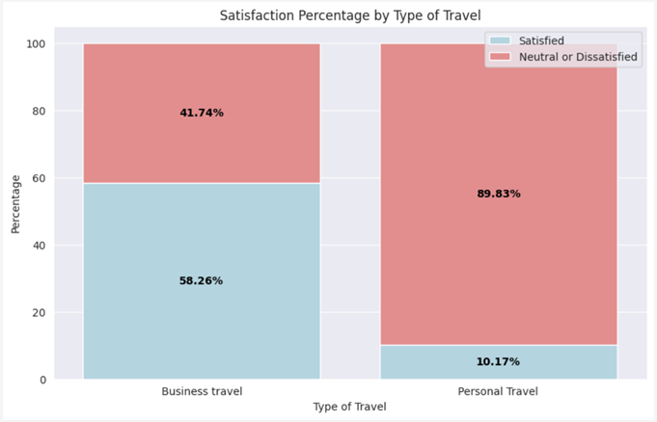
DISTRIBUTION OF ‘TYPE OF TRAVEL’ AND ‘TRAVEL CLASS’
"Business Travelers show a significantly higher satisfaction rate compared to Personal Travelers, with the majority of Business Travelers expressing satisfaction, whereas the majority of Personal Travelers tend to express neutrality or dissatisfaction."

Slide 24
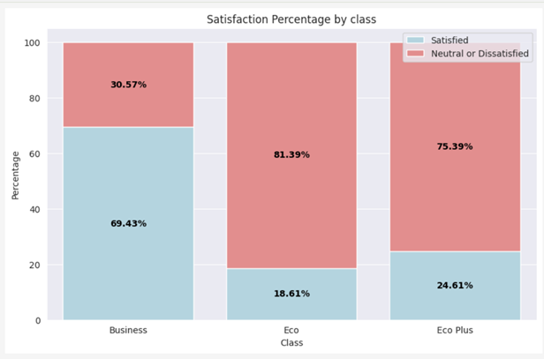
DISTRIBUTION OF ‘TYPE OF TRAVEL’ AND ‘TRAVEL CLASS’
The data reveals that 'Business Class' has the highest proportion of satisfied customers, accounting for 69.43% of total satisfaction across all classes. Conversely, 'Eco Plus Class' exhibits the highest percentage of dissatisfied or neutral customers, comprising 75.39% of such sentiments across all classes.

Slide 25
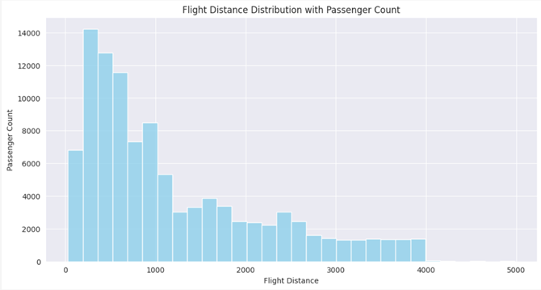
DISTRIBUTION OF FLIGHT DISTANCE

Slide 26
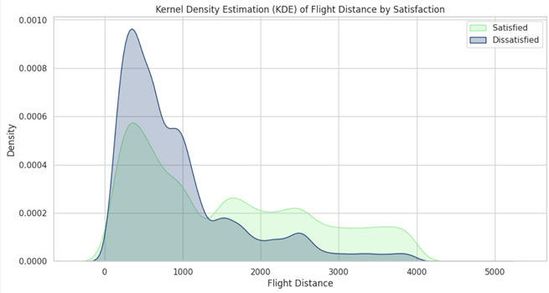
DISTRIBUTION OF FLIGHT DISTANCE
There appears to be a positive correlation between travel distance and satisfaction, suggesting that longer journeys are more likely to result in higher satisfaction. This correlation may be attributed to the observation that services on longer flights tend to be of higher quality compared to shorter ones.

Slide 27
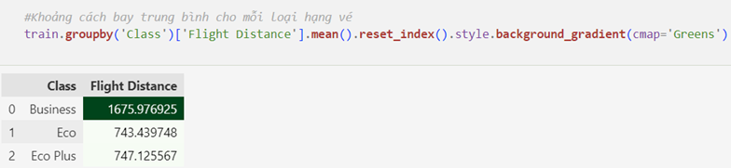
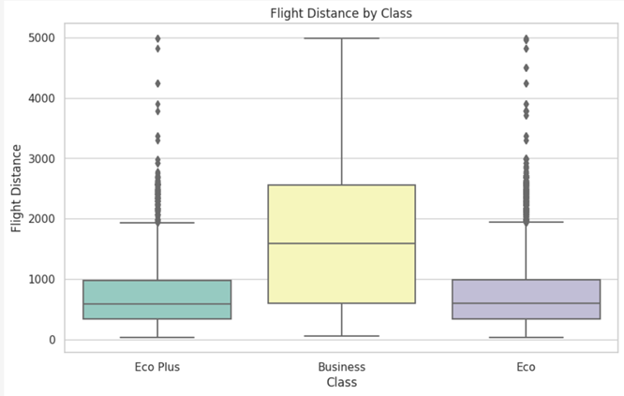
DISTRIBUTION OF FLIGHT DISTANCE
AVERAGE FLIGHT DISTANCE FOR EACH CLASS OF TRAVEL
Business Class travelers, on average, cover longer flight distances compared to passengers in Economy Class and Economy Plus Class. In contrast, the flight distances for Economy Class and Economy Plus Class are notably shorter and exhibit a similar range.

Slide 28
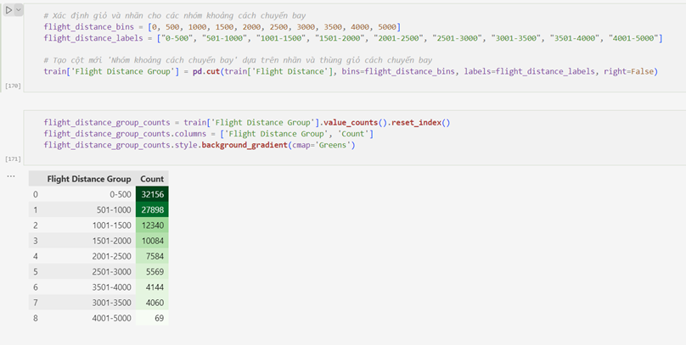
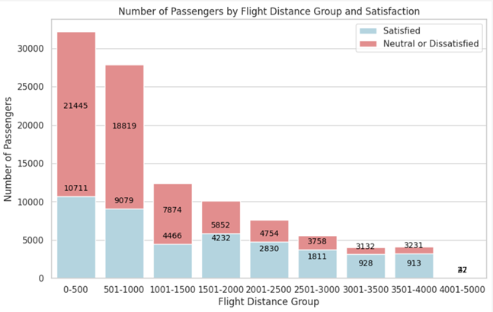
DISTRIBUTION OF FLIGHT DISTANCE
AVERAGE FLIGHT DISTANCE FOR EACH CLASS OF TRAVEL
The majority of flights are concentrated within shorter distance ranges (0-500 miles and 501-1000 miles), with a gradual decrease in count as the flight distance range expands. The data offers a comprehensive overview of flight distribution across different distance groups.

Slide 29
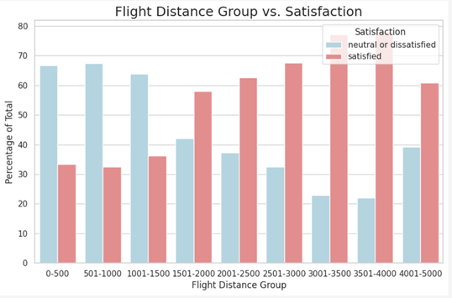
DISTRIBUTION OF FLIGHT DISTANCE
CORRELATION BETWEEN TRAVEL CLASS AND SATISFACTION LEVELS
Generally, shorter-distance flights tend to have lower satisfaction levels, whereas long-distance flights exhibit a mix of satisfaction and neutral/dissatisfied sentiments. Some distance groups show a majority of passengers expressing satisfaction.

Slide 30
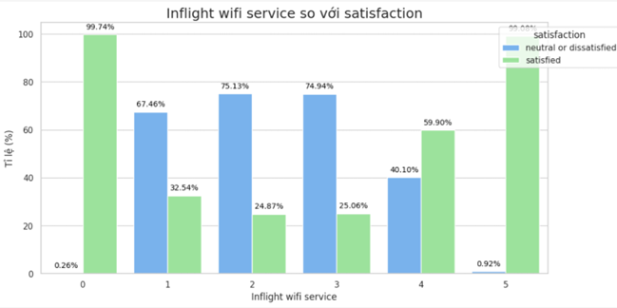
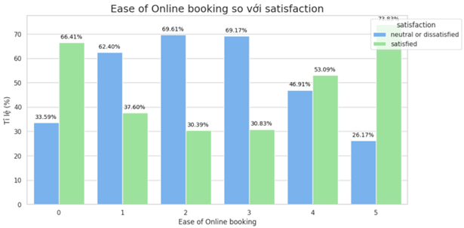
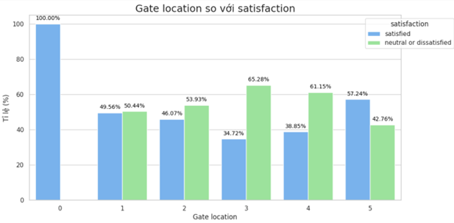
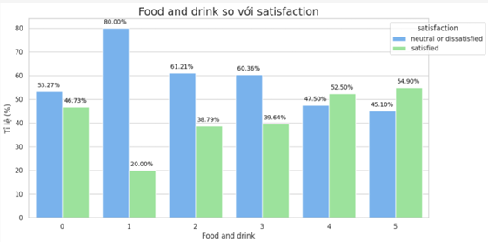
SERVICE QUALITY ANALYSIS
Let see what service factors have the highest and lowest satisfaction levels:

Slide 31
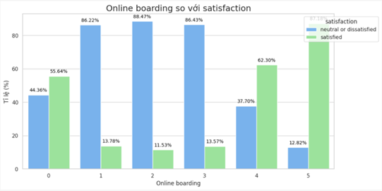
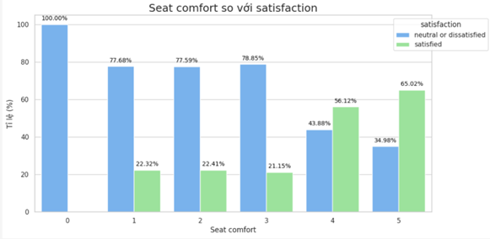
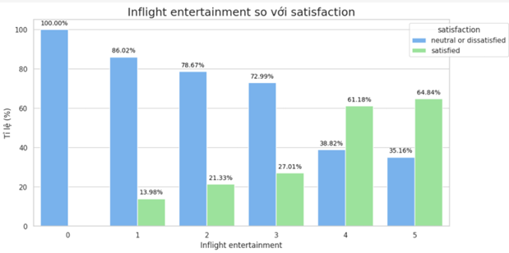
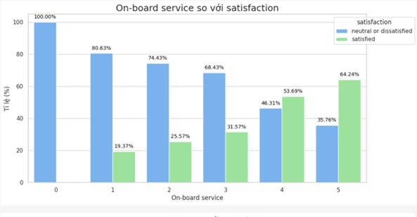
SERVICE QUALITY ANALYSIS
Let see what service factors have the highest and lowest satisfaction levels:

Slide 32
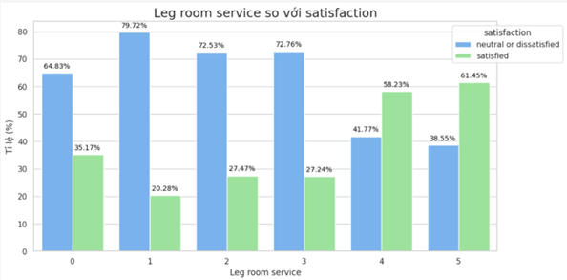
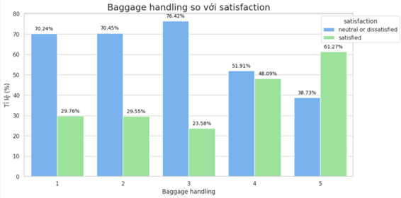
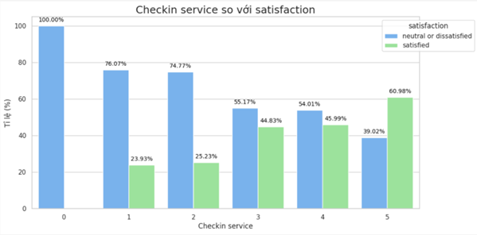
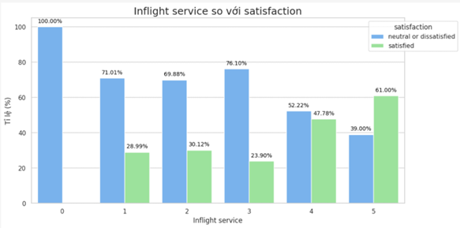
SERVICE QUALITY ANALYSIS
Let see what service factors have the highest and lowest satisfaction levels:

Slide 33
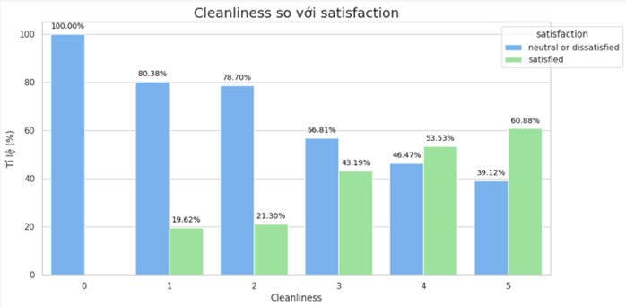
SERVICE QUALITY ANALYSIS
Let see what service factors have the highest and lowest satisfaction levels:

Slide 34
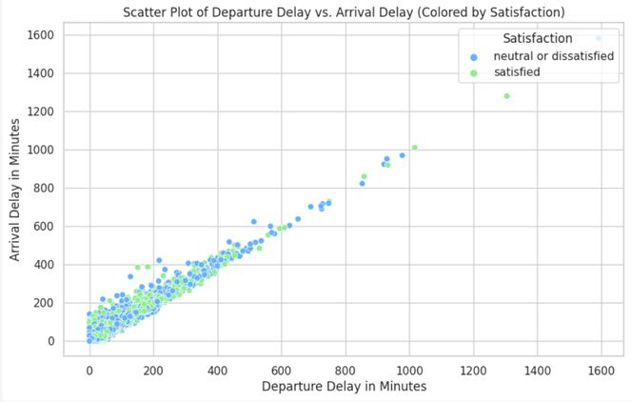

CORRELATION BETWEEN DELAYS (DEPARTURE AND ARRIVAL) AND SATISFACTION LEVELS
Individuals expressing neutral or dissatisfied sentiments frequently encounter more significant delays in their journeys compared to satisfied passengers. This underscores the pivotal role that punctuality and minimal delays play in shaping overall customer satisfaction.

Slide 35
3. DATA PREPROCESSING

Slide 36

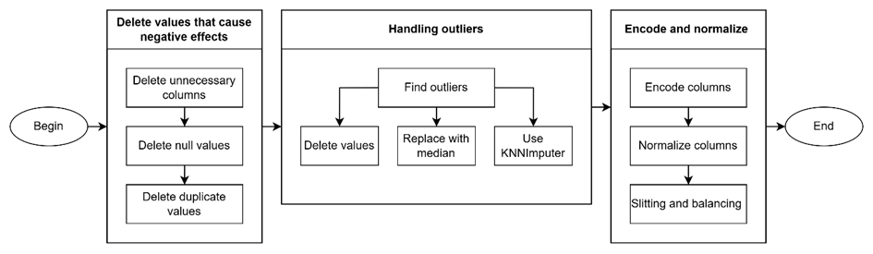
DATA PREPROCESSING

Slide 37
DATA PREPROCESSING
delete unnecessary columns
id and # columns dont use in any model so we can delete these columns

Slide 38
DATA PREPROCESSING
delete null value
We can see that in this column has ~0,2 null value, so we can delete them in train and test dataset

Slide 39
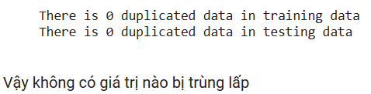
DATA PREPROCESSING
Determine duplicated value

Slide 40
DATA PREPROCESSING
Handing outliers
Using quantile ranges to divide values into 4 parts, each part representing 25%.
Find the interquartile range.
Determine the lower bound and upper bound beyond which any values are considered outliers.

Slide 41
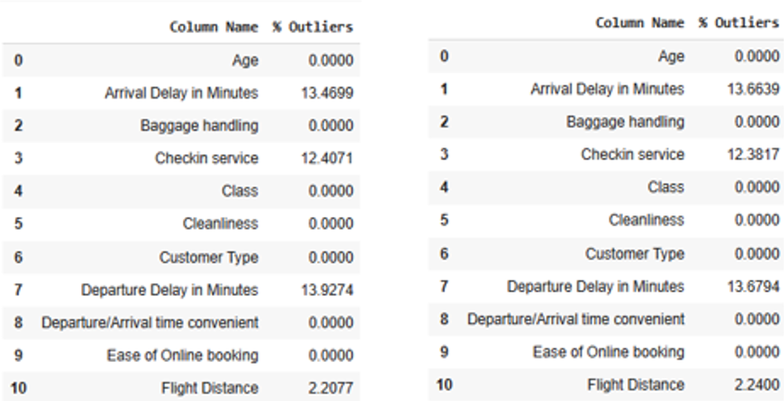
DATA PREPROCESSING

Slide 42
DATA PREPROCESSING
Handling outliers
In the 'Flight Distance' column, since the percentage of outliers is quite small, approximately 2%, we can consider removing these values.

Slide 43
DATA PREPROCESSING
Handling outliers
In the 'Checkin service' column, as the values range from 0 to 5 and outliers constitute approximately 12%, we can use the median to replace these outliers.

Slide 44
DATA PREPROCESSING
Handling outliers
In the 'Departure Delay in Minutes' column, we can use the KNNimputer algorithm to replace outliers with a specified value of n_neighbors = 5. This means utilizing the values of the five nearest neighbors to predict the outlier values.

Slide 45
DATA PREPROCESSING
Encode
Encode the rating values to a range from 0 to 1 to facilitate faster processing by algorithms.

Slide 46
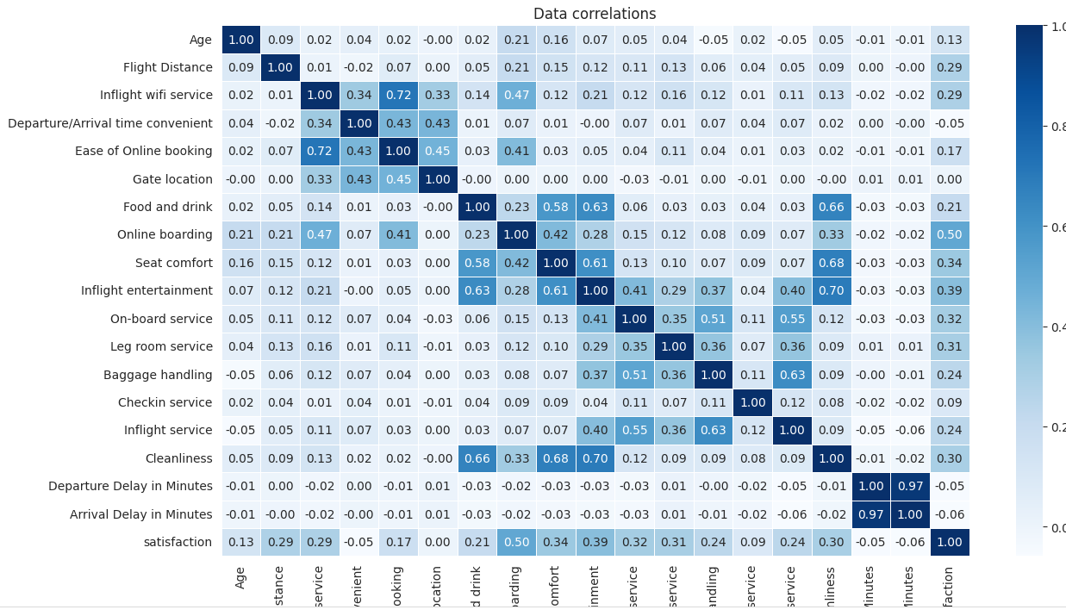
DATA PREPROCESSING

Slide 47
DATA PREPROCESSING
Unnecessary Features
It can be observed that columns such as 'Gender,' 'Arrival Delay in Minutes,' 'Gate location,' 'Departure/Arrival time convenient' exhibit low data correlation, making them unnecessary for the algorithm.

Slide 48
DATA PREPROCESSING
One hot encoding
Utilize the one-hot encoding algorithm for the columns ['Customer Type', 'Type of Travel', 'Class']. Since these columns do not have ordinal distinctions (no inherent order), employing this algorithm is appropriate.

Slide 49
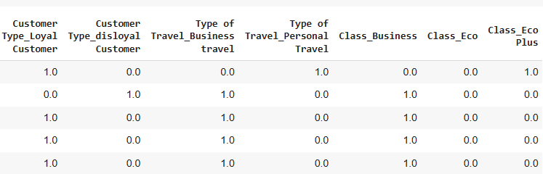
DATA PREPROCESSING
One hot encoding

Slide 50
DATA PREPROCESSING
Standardization
Standardization scales features by subtracting the mean and then dividing by the standard deviation. This results in features that have a mean of 0 and a standard deviation of 1.

Slide 51
DATA PREPROCESSING
Balance dataset
There is an imbalance in the outcome variable, with more occurrences of 0 indicating "Neutral or dissatisfied" compared to 1 indicating "Satisfied."

Slide 52
DATA PREPROCESSING
Balance data
Utilize the Random Over-sampling method with a seed value of 42. This method involves increasing the number of samples in the minority class by randomly duplicating existing samples.

Slide 53
4. EXPERIMENTAL

Slide 54

SVM ALGORITHM
Support Vector Machine (SVM) model works by finding a hyperplane in a high-dimensional space (corresponding to the number of features in the data) in such a way that it optimally classifies data points into different classes

Slide 55
SVM ALGORITHM
Hyperplane is chosen so that the distance from the hyperplane to the nearest data points (known as support vectors) is maximized. The goal of SVM is to maximize the margin between classes, which is synonymous with optimizing classification performance.

Slide 56
SVM ALGORITHM
Our team utilizes the default kernel, which is the Radial Basis Function (RBF), and applies a value of C equal to 1.0.

Slide 57
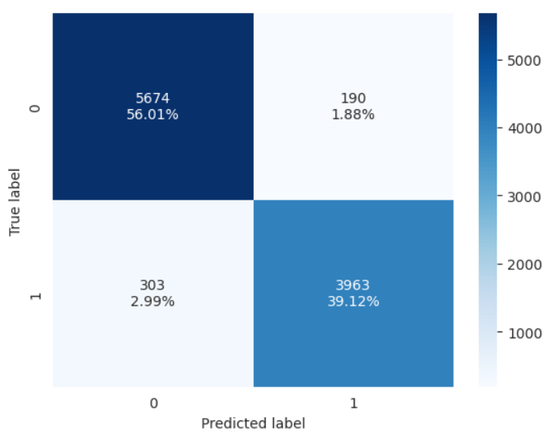
SVM ALGORITHM

Slide 58
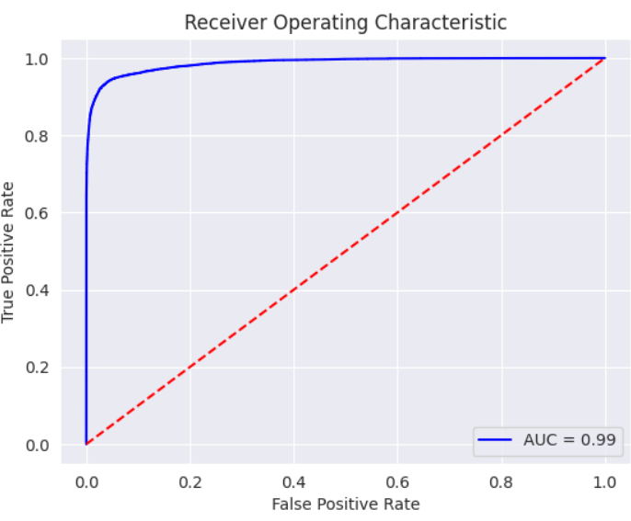
SVM ALGORITHM

Slide 59
KNN ALGORITHM
Based on the assumption that data points with similar labels tend to have similar features.
To predict the label of a new data point, K-Nearest Neighbors (KNN) identifies its nearest neighbors in the feature space and predicts the label based on the majority label among those neighbors.

Slide 60
KNN ALGORITHM
Choose the number of neighbors (K): This is the number of nearest data points the algorithm will consider for making predictions.
Define a distance measure: Use a distance metric (usually Euclidean distance) to determine the nearest neighbors.

Slide 61

KNN ALGORITHM
Pros:
Easy to understand and implement.
Doesn't make assumptions about the distribution of data.
Cons:
Sensitive to noise and outliers.
Requires careful selection of the K value, and there's no specific rule for choosing K.

Slide 62
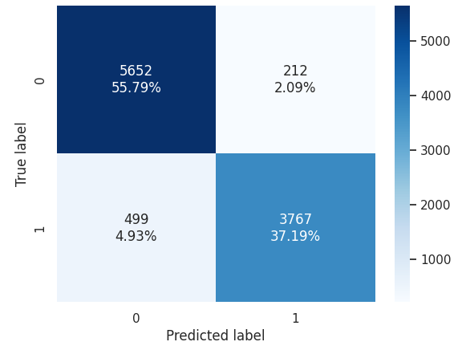
KNN ALGORITHM

Slide 63

KNN ALGORITHM

Slide 64
NAIVE BAYES ALGORITHM
Naïve Bayes is a class of algorithmic analysis modeled on Bayesian reasoning in validation lists, used in many types of task assignment.
When independence is assumed, Naive Bayes performs better than other models such as logistic regression.

Slide 65

NAIVE BAYES ALGORITHM

Slide 66

NAIVE BAYES ALGORITHM

Slide 67

DECISION TREE ALGORITHM
Decision tree, one of the most widely used algorithms in machine learning, is an explainable and white box algorithm that shows classification results using an if-then rule format [15]. It is used in both classification and regression problems. In a decision tree, every node symbolizes a feature, each branch indicates a rule, and every leaf represents a result, either a specific value or the continuation of further branching.

Slide 68

DECISION TREE ALGORITHM

Slide 69

DECISION TREE ALGORITHM

Slide 70
5. EVALUATION

Slide 71

DISCUSSION
Results above 0.8 across KNN, SVM, Naïve Bayes, and Decision Tree indicate excellent performance, attributed to quality data and effective processing.
SVM emerges as the most promising model, excelling in high-dimensional datasets typical of air travel satisfaction analysis.
Naïve Bayes shows less favorable performance due to oversimplified assumptions in handling intricately interrelated factors.
Our machine learning exploration concludes with SVM as the optimal choice for predicting customer satisfaction in air travel, meeting our objectives.

Slide 72
6. CONCLUSION

Slide 73

CONCLUSION
Future research could explore advanced machine learning models and real-time data streams for enhanced accuracy. Additionally, integrating customer feedback loops and sentiment analysis tools would offer actionable insights for immediate service improvements.
Our ongoing commitment to leveraging cutting-edge technologies is crucial in meeting evolving passenger expectations and ensuring sustained customer loyalty.

Slide 74





THANK YOU

